Slide 1
A new mechanism for forming weathered crust elution deposited REE ores?
September 2016, EKSTU, Kazakhstan
Liam Hardy L.Hardy2@Brighton.ac.uk

Slide 2
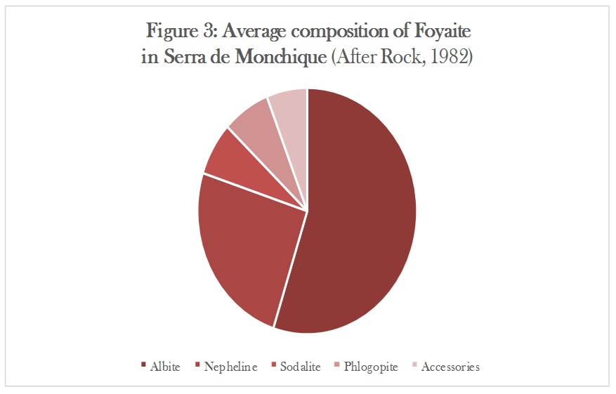
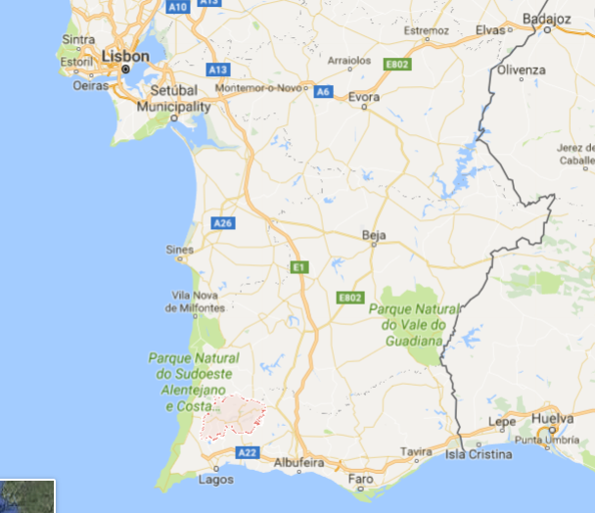
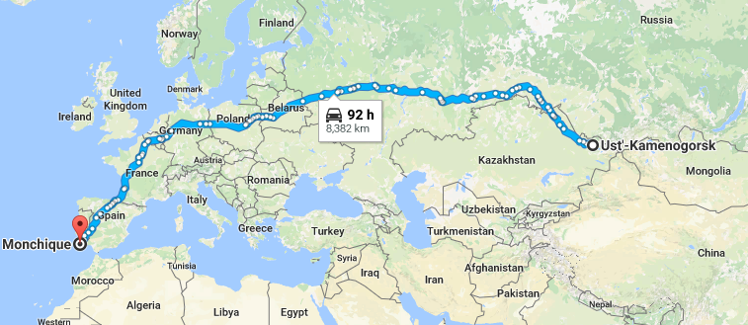
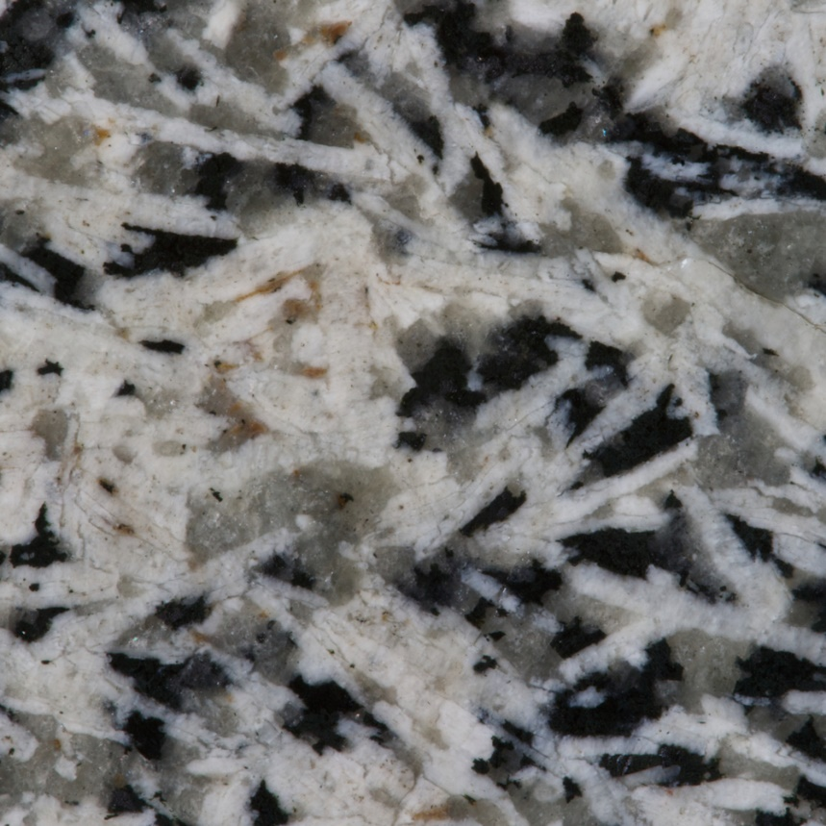
Serra de Monchique, Portugal
63km2 nepheline-syenite (Foyaite) laccolith
Pedogenetic cover variable - >10cm ~ <35m
Y values of <160ppm in clay zones & some 780ppm in other formations. 10-20% recoverable at this stage…
So far:
Mapping of soil cover and bedrock in HD
XRD analysis of bulk soil, bedrock and clay separates
Sequential leaching of profiles (after Sanematsu & Moldoveanu)
Parallel tests on profiles from Longnan Province (China), Mt. Vulture (Italy), Yarpuz (Turkey).
1cm

Slide 3
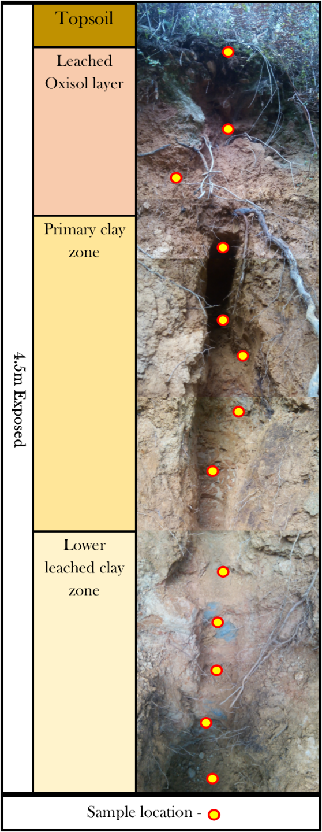
30-50ppm of Y, Nb, Zr is seasonally mobile within the profile. Concentrating within mottled clays in dry season and c.1.5m above at the oxisol to-clay contact during wet season.
Nb & Zr leached/unweathered in detrital grains at surface

Slide 4
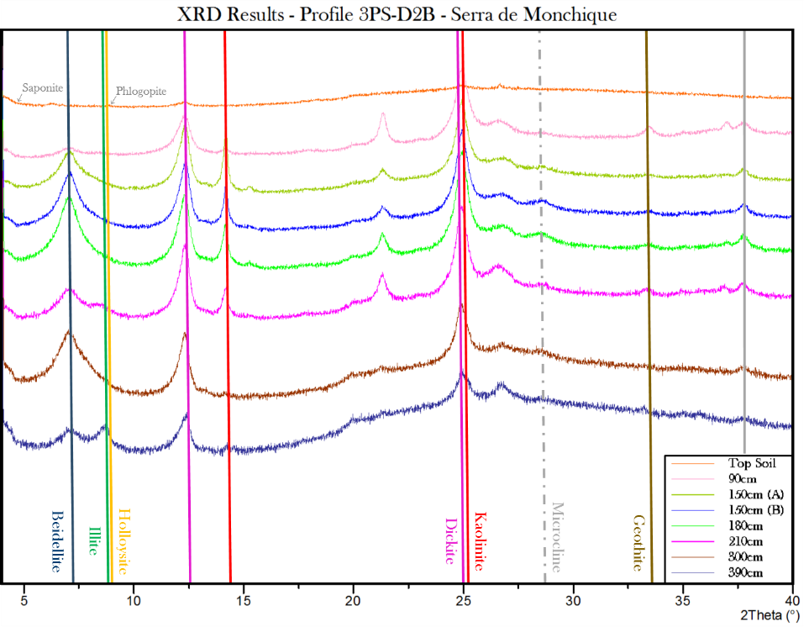
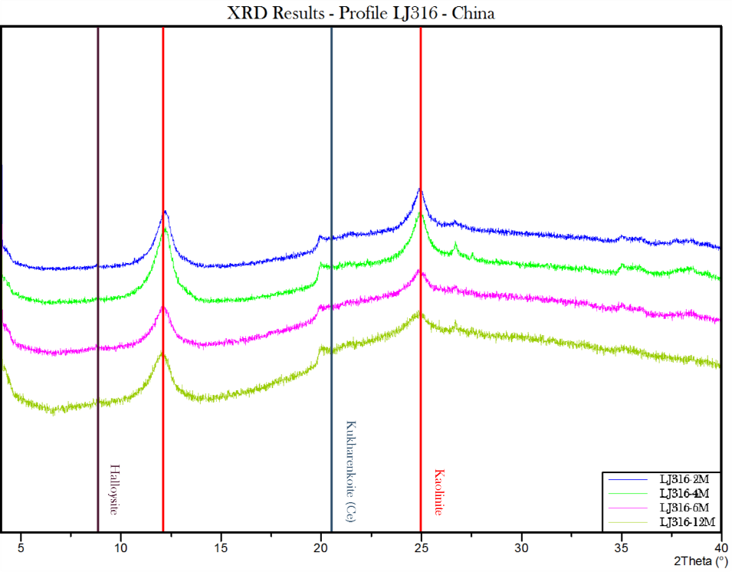
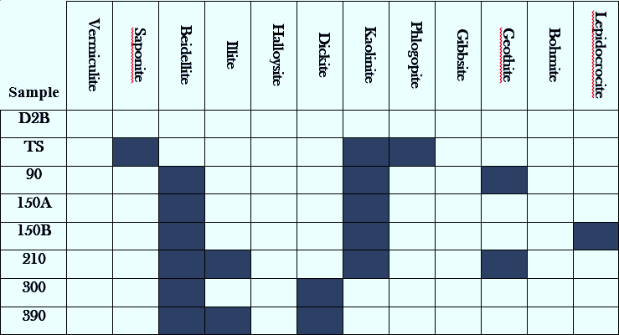

Slide 5
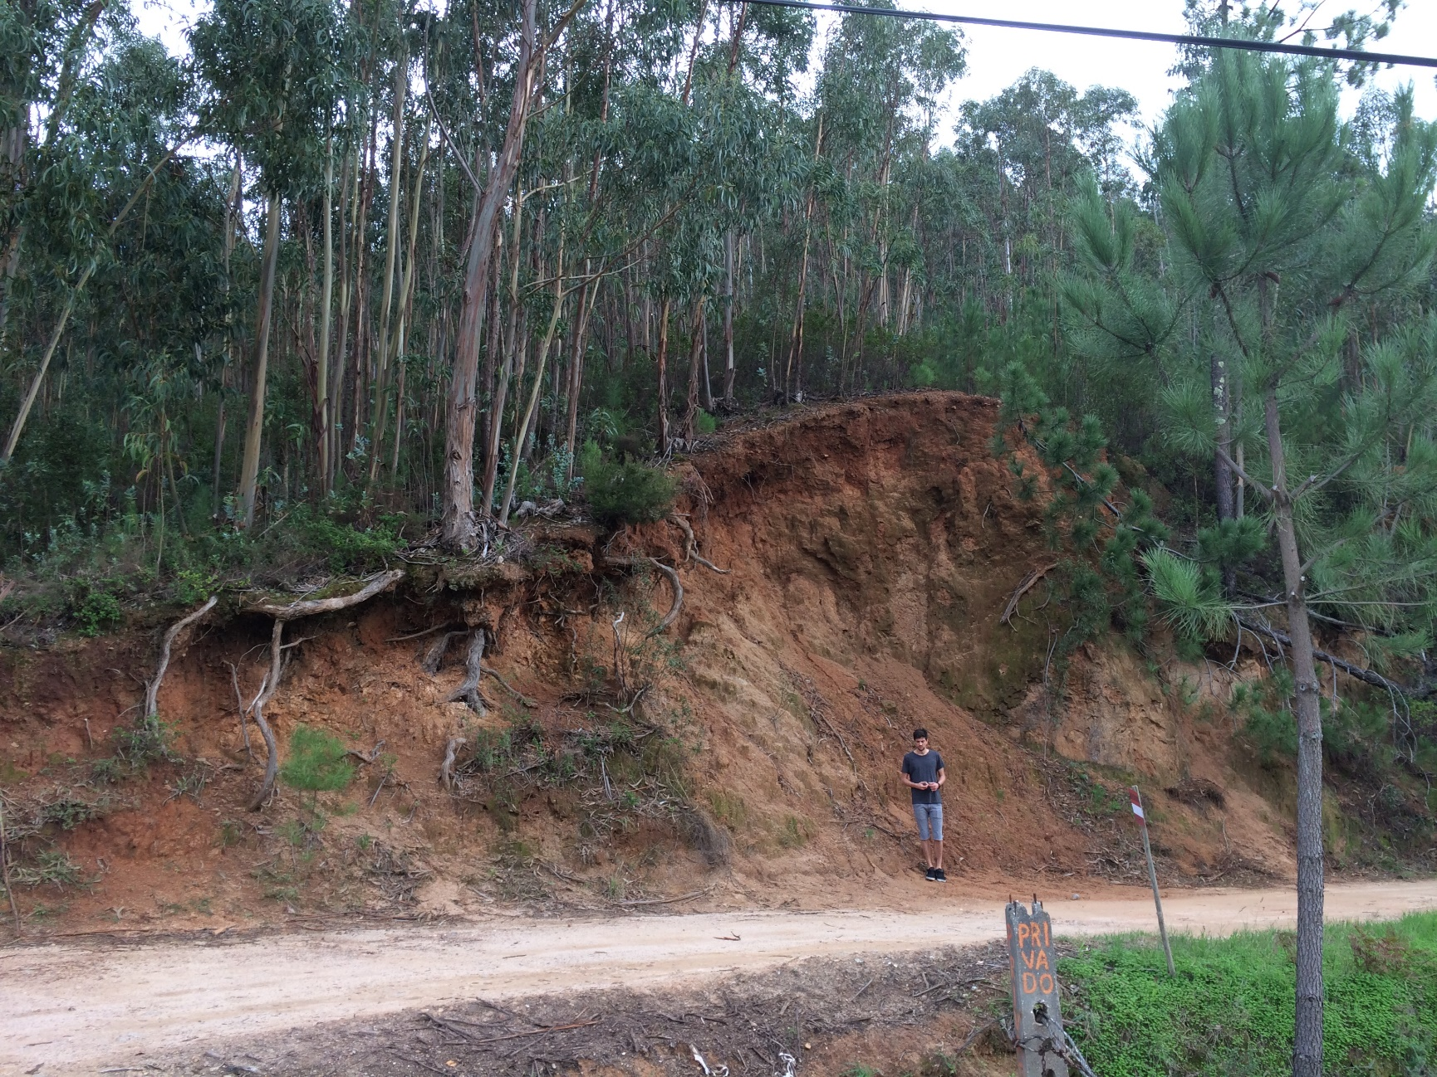
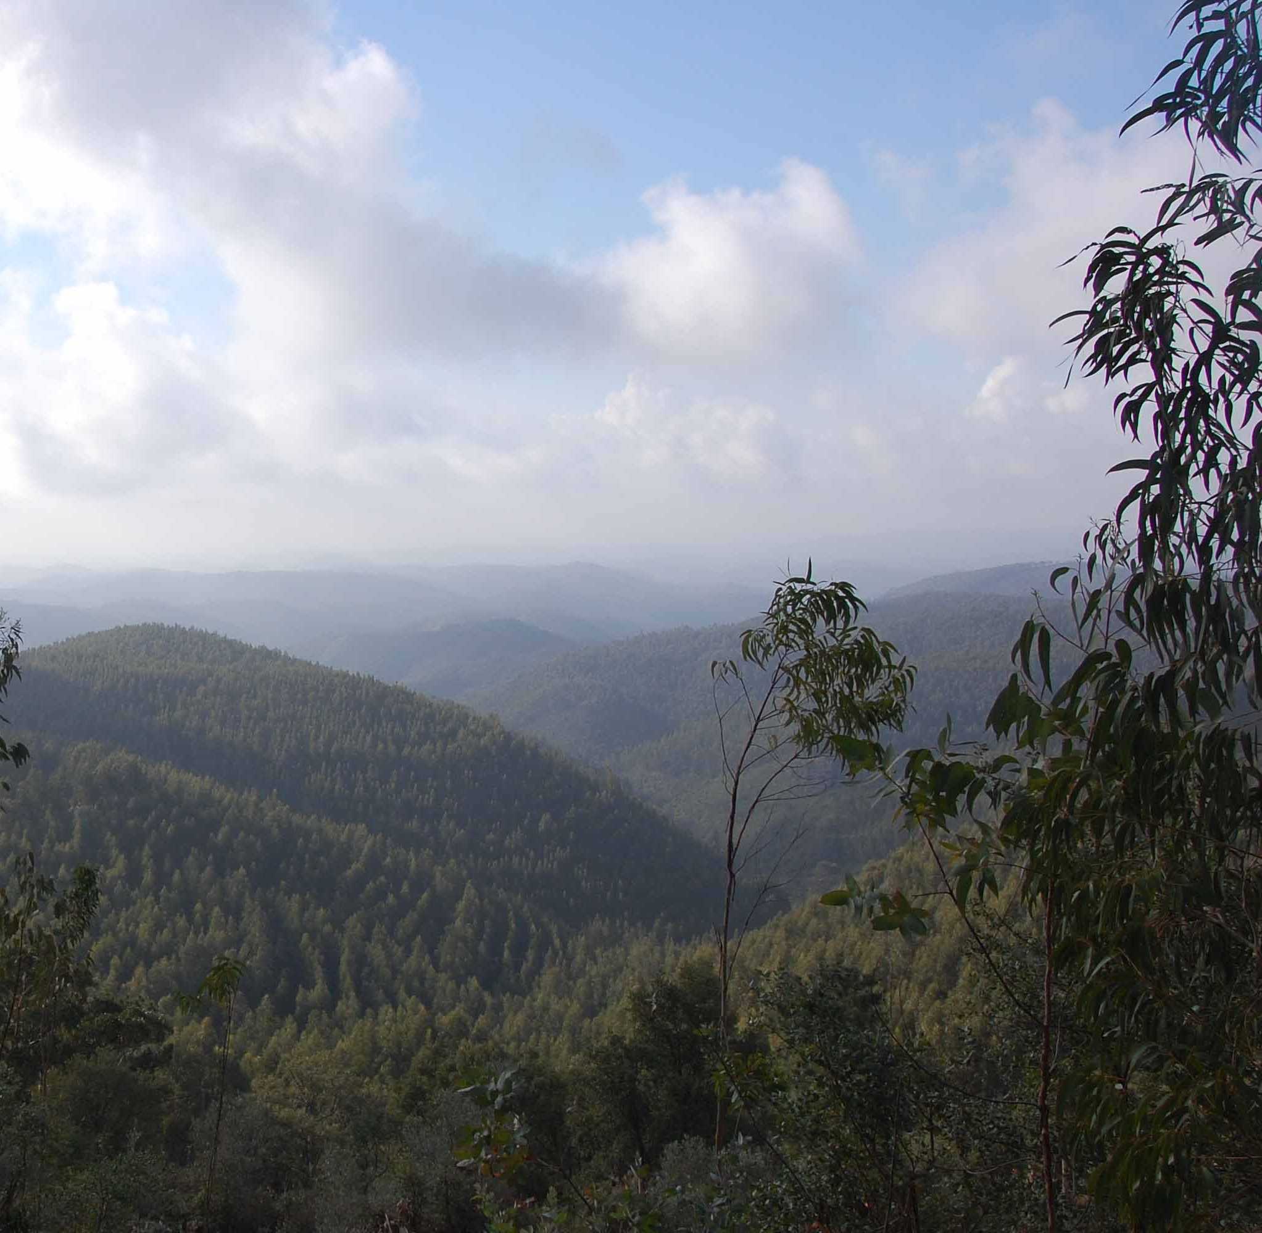
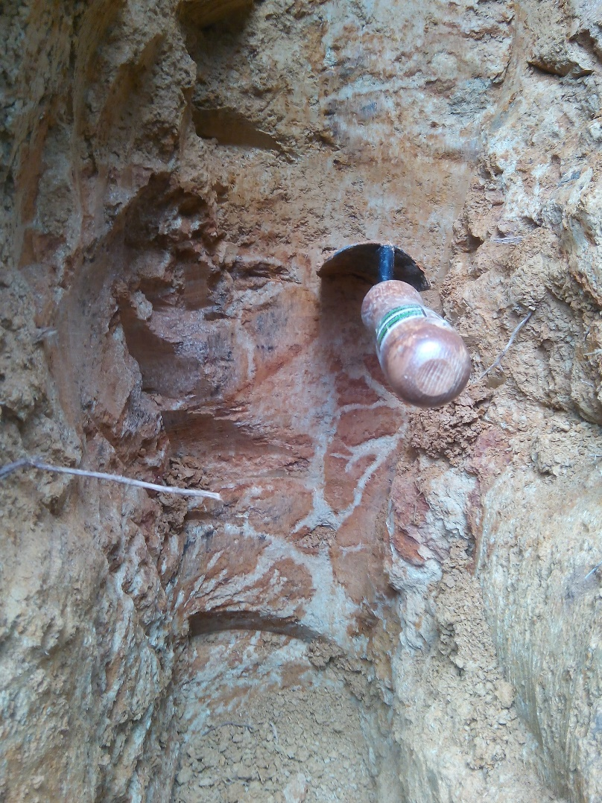
So, is this a live, here and now, visibly forming ion-adsorption HREE deposit?
Maybe.

Slide 6
Brighton University has a brand new geochemical laboratory and a great team of researchers, we welcome collaborations and further discussions regarding resource scarcity, mining and sustainable exploration in Kazakhstan.
Thank you to everybody who has been involved with organising and funding this fantastic workshop, I hope it brings many great opportunities to all involved and to development in Britain & Kazakhstan.
Liam Hardy University of Brighton L.Hardy2@Brighton.ac.uk

